Slide 2
Contents
Introduction…………………………………………………………………………………………………..3
Incidence and risks of late-onset AIDS-defining opportunistic infections (LOIs)……………………..5
Tuberculosis (TB): Detection, diagnosis..….……………………………………………………………..6
Tuberculosis (TB): Preventive therapy……………………..……………………………………………..7
Hepatitis: Acquisition, treatment……………………………….…………………………………………..8
Sexually transmitted infections (STIs): Transactional sex, acquisition….……………………………..9
Hypertension and diabetes…………………………………………………………………………………10

Slide 3
Introduction
Forty years since the start of the epidemic, the response to HIV is in a transformative moment from a traditional vertical and humanitarian approach to an approach which is integrated in wider programmes at country level through global health frameworks such as the Sustainable Development Goals (SDGs) or Universal Health Coverage (UHC) in order to more comprehensively cover the co-infections affecting people living HIV, such as hepatitis and sexually transmitted infections. [1-5]
Additionally, people living with HIV who are immunosuppressed have an increased risk of experiencing diseases caused by opportunistic infections, such as tuberculosis (TB) and cryptococcal meningitis, which thus require specific preventative, diagnostic and treatment services as part of an advanced HIV disease (AHD) service package.
Attention to the holistic health, care and well-being needs of people living with and most vulnerable to HIV is an essential aspect of an effective HIV response.
Person-centred care can enable greater attention to meeting the complex and evolving health and well-being needs of people living with and vulnerable to HIV.
[1] Bekker L-G, Alleyne G, Baral S, et al. Advancing global health and strengthening the HIV response in the era of the Sustainable Development Goals: the International AIDS Society–Lancet Commission. Lancet 2018; published online July 19. http://dx.doi.org/10.1016/S0140-6736(18)31070-5
[2] Keletso Makofane, Bruno Spire, Phumi Mtetwa. Tackling global health inequities in the HIV response. Published Online July 19, 2018 http://dx.doi.org/10.1016/ S0140-6736(18)31441-7
[3] Kent Buse; Jonathan Jay; Morolake Odetoyinbo. AIDS and universal health coverage—stronger together. The Lancet Global Health. Volume 4, issue 1, PE10-E11, January 2016. DOI:https://doi.org/10.1016/S2214-109X(15)00273-9
[4] GBD 2016 Causes of Death Collaborators. Global, regional, and national age-sex specific mortality for 264 causes of death, 1980–2016: a systematic analysis for the Global Burden of Disease Study 2016. Lancet 2017; 390: 1151–210.
[5] Global Burden of Disease Health Financing Collaborator Network. Future and potential spending on health 2015–40: development assistance for health, and government, prepaid private

Slide 4
Overview
HIV and co-infections
Incidence and risks of LOIs
TB: Detection, diagnosis
TPT
Hepatitis: Acquisition, treatment
STIs: Tx sex, acquisition
Hypertension, diabetes

Slide 5
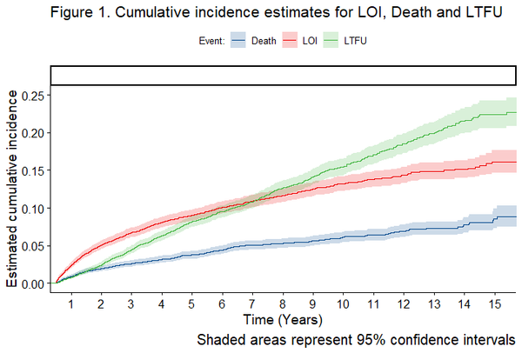
HIV and co-infections Incidence and risks of late-onset AIDS-defining opportunistic infections (LOIs)
Incidence of late-onset AIDS-defining opportunistic infections (LOIs) and associated factors largely unknown in resource-limited settings
Risk factors similar to those usually associated with early opportunistic infections
Isaac Núñez-Saavedra, OAB0202
Notes:
Late-onset opportunistic infections while on ART in Latin America
Isaac Núñez-Saavedra
Incidence of late-onset (occurring after six months of starting antiretroviral therapy [ART]) AIDS-defining opportunistic infections (LOIs) and factors associated with them are largely unknown in resource-limited settings. The aim of this study was to describe the incidence and risk factors of LOIs at five sites in Latin America as part of the Caribbean, Central and South America network for HIV epidemiology (CCASAnet).
All adult, ART-naive patients enrolled at CCASAnet sites in Argentina, Brazil, Chile, Honduras and Mexico from 2001 to 2015 who remained in care after six months of ART were included. Excluded were patients with unavailable prior AIDS status. Among those who developed a clinical outcome, median time to LOI, death and LTFU were reported. Using a Fine and Gray competing risk model (treating death and LTFU as competing events), the cumulative incidence of each outcome over time was estimated and calculated sub-distribution hazard ratios.
RESULTS
A total of 5,966 patients were eligible. Median follow-up was 5.5 (IQR 3.01-9.06) years. A total of 1,837 (31%) patients had a clinical outcome (701 [38%] were LOIs). Estimated cumulative incidence at five years was of 9% for LOIs, 8% for LTFU and 4% for death (Fig. 1). The most common LOIs were tuberculosis (27%), esophageal candidiasis (13%), and P. jirovecii pneumonia (12%). Median time to event was 2.5 years for LOIs, 3.4 for death and 4.5 for LTFU. Having an AIDS-defining event during the first six months of treatment (HR: 1.97 [1.57-2.46]) , lower CD4 count at ART start (HR: 1.33 [1.33-1.33] for CD4: 100 vs. CD4: 300), and starting ART earlier years (HR: 1.35 [1.33-1.37] for 2005 vs. 2015) were significantly associated with a higher risk of LOI. CONCLUSIONS
In our cohort, LOIs continued to occur late during follow-up. Risk factors were similar to those usually associated with early opportunistic infections. Closer long-term follow-up may be warranted in patients with lower CD4 counts at ART start and those initiating during the earlier years of the cohort.

Slide 6
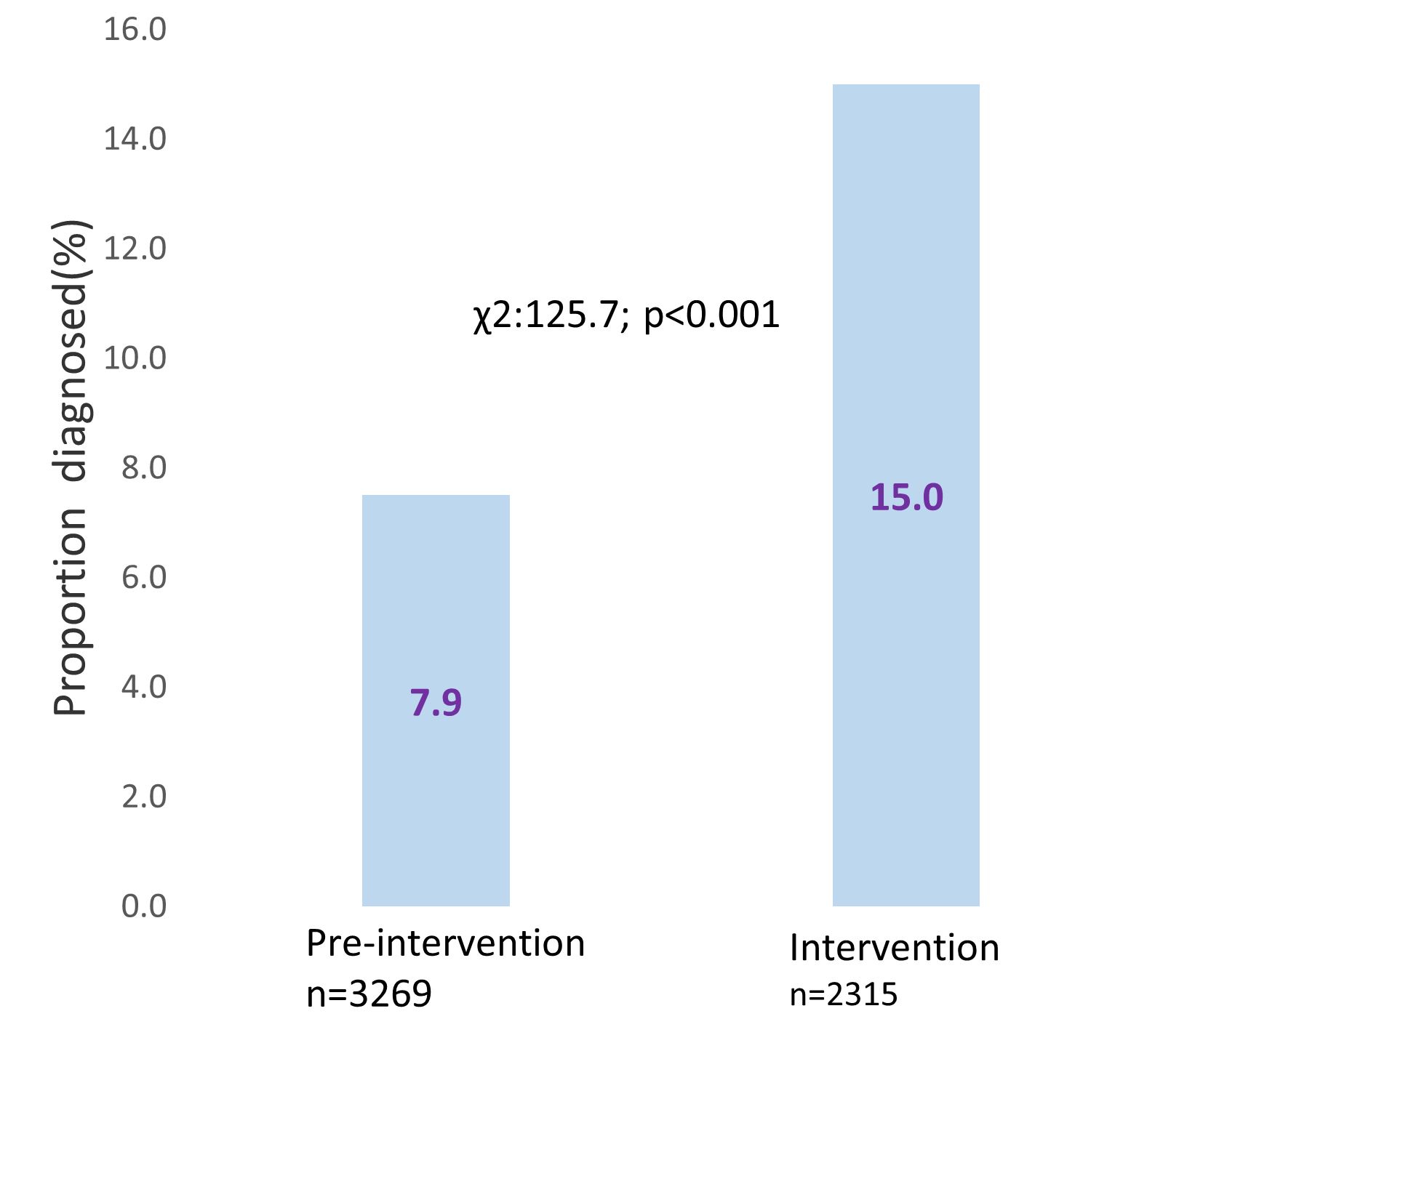
HIV and co-infections
Tuberculosis (TB): Detection, diagnosis
Systematic screening for HIV, TB and enhanced TB diagnostic package for hospitalized patients significantly improved TB diagnosis rate
Nix-TB trial achieved 92% treatment success among XDR and treatment-intolerant or non-responsive multidrug-resistant TB (MDR TB).
51% were HIV positive. However, HIV status did not affect the successful treatment outcomes
Proportion of patients diagnosed with TB by study phase
A.B. Bulti et al, PEB0131
Morounfolu Olugbosi, OAB0502
Notes:
AB Bulti et al.: Enhanced tuberculosis screening and diagnosis for hospitalized individuals in a high HIV-prevalence setting in KwaZulu-Natal, South Africa: A before and after study (PEB0131)
Despite the advances in TB diagnostics, up to one-third of TB cases remain undiagnosed.
This study describes the changes in TB case finding after implementation of TB diagnostic intervention for patients hospitalized in two district hospitals in a rural KwaZulu-Natal, South Africa.
Design: A before (pre-intervention) and after (intervention) study.
Patients aged ≥18 admitted in Eshowe and Mbongolwane Hospitals, Kwazulu-Natal, South Africa. were enrolled.
METHODS
Patients aged ≥18 years admitted to Eshowe and Mbongolwane hospitals were provided with systematic screening and enhanced diagnostic packages for HIV, diabetes, and TB during the intervention period, as shown in the table. A comparison of TB diagnosis and in-hospital mortality was made with the pre-intervention period. Pre-intervention period (March 2018 to November 2019) Intervention period (March 2019 to November 2019) Diabetes screening and diagnosis Random blood sugar (RBS) by glucometer clinically prompted Systematic screening by RBS by glucometer and confirmation by fasting blood sugar or with HbA1c HIV screening and diagnosis HIV testing clinically prompted HIV testing provided for all admitted patients TB screening and diagnosis Symptom-based screening not systematically done Systematic symptom screening after TB education by community health workers Xpert MTB/RIF Ultra if a clinical presumption of TB Xpert MTB/RIF Ultra provided for HIV-positive, diabetic patients regardless of symptoms and for HIV-negative patients with symptoms Culture for presumptive TB but negative GeneXpert No use of urine Determine TB- lipoarabinomannan (TB-LAM) Systematic urine TB-LAM for HIV-positive patients regardless of symptoms or CD4 count Chest X-ray (CXR) done for presumptive TB patients and interpreted by medical officers CXR was systematically done for all HIV-positive diabetics regardless of symptoms and in HIV-negative patients with TB symptoms CXR interpreted by expert radiologists via telemedicine when medical officers needed further advice RESULTS
Of 3,269 patients enrolled in the pre-intervention period, the median age was 50 years (interquartile range [IQR]: 32-67) and 1,852 (56.7%) were females. Of 2,315 patients enrolled during the intervention period, the median age was 53 years (IQR: 34-68) and 1,476 (63.7%) were females. TB diagnosis was higher in the intervention period (347 [15.0%] vs. 259 [7.9%]), showing an increase of 89.9% (p<0.001). Among those diagnosed with TB, 72.3% (170/235) in the pre-intervention and 73.3% (251/342) in the intervention had HIV co-infection. TB-related in-hospital mortality was lower in the intervention period (13.3% vs. 15.4%; p=0.316).
Results
Pre-intervention phase
3,269 patients included
Median age: 50 yrs (IQR: 32-67)
56.7% were females
259 (7.9%) diagnosed with TB
170/235 (72.3%) HIV co-infected
14/228 (6.1%) had DM
40(15.4%) died during hospitalization
Intervention phase
2,315 patients enrolled
Median age: 53 yrs (IQR: 34-68)
63.7% were females
347 (15.0%) diagnosed with TB
251/342 (73.3%) HIV co-infected
24/347 (6.9%) had DM
46 (13.3%) died during hospitalization
CONCLUSIONS
Systematic screening for HIV, TB and enhanced TB diagnostic package for hospitalized patients significantly improved TB case detection and shortened time to TB diagnosis. This should be part of routine hospital care in a high TB and HIV burden settings.
https://cattendee.abstractsonline.com/meeting/9289/presentation/76
Efficacy and safety outcomes (HIV subgroup analysis) in the Nix-TB Trial – bedaquiline, pretomanid and linezolid for treatment of extensively resistant, intolerant or non-responsive pulmonary multidrug-resistant tuberculosis (OAB0502)
Morounfolu Olugbosi:
- Nix-TB achieved 92% treatment success among 109 XDR and treatment-intolerant or non-responsive (TI/NR) MDR-TB patients in South Africa, with a three-drug, all-oral, six-month regimen of bedaquiline, pretomanid and linezolid (BPaL). Half of the study population (51%) were HIV positive.
- Nix-TB is an open-label, single-arm study of extensively drug-resistant (XDR) or treatment-intolerant or non-responsive (TI/NR) MDR-TB patients, with primary endpoint of relapse-free microbiologic and clinical cure six months after end of therapy. Safety data analysis was descriptive with no inferential tests carried out. HIV-positive patients were required to have CD4+ >50 cells/μL and be able to receive allowed ARV regimens (NVP-, LPV/r-, or RAL-based with NRTIs). Here, we present a HIV subgroup analysis of the efficacy and safety data from the study.
RESULTS: A total of 56 HIV-positive patients (of 109 total) were on ARV therapy prior to enrolment. Thirty-nine patients (69.6%) switched pre-enrolment ARV to allowed regimens and these were all changes from EFV- regimens to either LPV/r- or NVP- regimens. CD4 count was available for 51 participants with mean, median and range of 394, 343, 55 -1,023 cells/μL respectively.
Success at the primary endpoint was 91% (95% CI, 80-97) in HIV-positive and 92% (95% CI, 81-98) in HIV-negative patients. Results from a Cox regression model showed that HIV status did not affect time to negative culture conversion status [hazard ratio 0.78 [95% CI, 0.50, 1.19]; p=0.249].
Among HIV-positive and HIV-negative patients, Grade 3 or 4 TEAEs were reported in 62.5% and 50.9%, hepatic TEAEs in 46.4% and 30.2%, peripheral neuropathy in 78.6% and 83%, hematopoietic cytopenias in 53.6% and 41.5%, and serious TEAEs in 16.1% and 17.0%, respectively. Of the eight reported deaths (7.3% of total study population), five (8.9%) and three (5.7%) were in the HIV-positive and HIV-negative population, respectively.
All surviving patients (irrespective of HIV status) were able to complete the full 26 weeks of therapy.
CONCLUSIONS: Results of this simplified, shortened all-oral regimen for highly drug-resistant TB show sustained high efficacy and manageable safety irrespective of HIV status.

Slide 7
HIV and co-infections
Tuberculosis (TB): Preventive therapy
Gaps and success in TB cascade in children living with HIV on ART
Despite reducing mortality among people living with HIV, TB preventive therapy (TPT) scale up has been limited, with TPT completion rates at:
29%-91% in adults; 8%- 92% in children
adults rates were 10-35% higher than children (in six countries)
Monita R. Patel, OAB0504
Pooja Vinayak, PEE1617
Notes:
Assessment of the tuberculosis clinical cascade among children living with HIV on antiretroviral therapy, 16 sub-Saharan PEPFAR-supported programmes, 1 October 2018 to 31 March 2019
Monita R Patel
- Tuberculosis (TB) is underreported and contributes to substantial morbidity and mortality in children, particularly children living with HIV. We examined The US President's Emergency Plan for AIDS Relief (PEPFAR) data to identify opportunities to reduce TB burden among children living with HIV.
- We analysed PEPFAR data for children living with HIV (<15 years) on antiretroviral treatment (ART) from 1 October 2018 to 31 March 2019. Of 21 PEPFAR-supported countries in sub-Saharan Africa, five were excluded due to non-reporting of age-disaggregated TB data. The remaining 16 were categorized by region, high paediatric TB incidence ('¥25,000 per 100,000), and a high burden among children living with HIV ('¥60,000). We analysed these TB cascade indices: TB symptom screening coverage (percentage screened at least once); screening positivity (percentage with positive screen); proxy TB treatment initiation rate (percentage with positive screen initiating TB treatment); proxy TB preventive therapy (TPT) initiation rate (percentage with negative screen initiating TPT); and TPT completion (percentage initiating and completing TPT).
RESULTS
In total, 555,851 children living with HIV were included, representing 86% of children living with HIV on ART across PEPFAR-supported programmes. Of these, most were screened for TB (median 93%, interquartile range [IQR]: 86%-100%); however, few (median 3%, IQR: 2%-6%]) screened positive. Of those screening positive, median TB treatment initiation rate was 19% (IQR: 15%-29%). A median 8% [IQR: 4%-11%]) of those screening negative initiated TPT. Of those initiating TPT, median completion was 72% (IQR: 47%-79%). TB cascade indices were similar by TB incidence and burden among children living with HIV; TPT completion was lower in western/central Africa (62%) despite higher TPT initiation (24%) (Figure). CONCLUSIONS
TB screening coverage was high, but screening positivity was lower than expected, suggesting poor screening quality. Low TPT initiation and completion underscores that national TPT plans should address paediatric-specific clinical guidance, supply chain and routine monitoring. Age-disaggregated TB diagnosis data are needed as proxies likely to underestimate TB treatment initiation and overestimate TPT initiation rates.
Pooja Vinayak: Adult and paediatric tuberculosis preventive therapy in selected PEPFAR-supported countries (PEE1617)
- Tuberculosis (TB) is the leading cause of death among people living with HIV worldwide and children with HIV are particularly vulnerable. TB preventive therapy (TPT) has been shown to decrease mortality among people living with HIV; however, scale up has been limited. In 2018, PEPFAR set ambitious targets for PEPFAR-supported countries to treat all people living with HIV with TPT by 2021. This report describes the completion rates of TPT in PEPFAR-supported countries among adults and children.
- We conducted a descriptive analysis of TPT completion data collected in PEPFAR-supported countries from October 2018 to September 2019. During that time, a total of 24 programmes reported TPT data to PEPFAR; five countries and one regional programme where less than 5% of patients on ART initiated TPT were excluded. Using country-specific data, we determined TPT completion rates among people living with HIV on ART during the one-year analysis period and compared completion rates among adults ('¥15 years) and children (<15 years).
LESSONS LEARNED
Among 18 countries, seven had TPT completion rates of >80% for both adults and children. TPT completion rates ranged from 29% to 91% for adults and 8% to 92% for children. Completion rates for adults and children were within 5% of each other in 11 countries, but adults had TPT completion rates ranging from 10% to 35% higher than children in six countries. The greatest discrepancies between adult and paediatric TPT completion were in Cameroon (adults 43%, children 8%), South Africa (adults 51%, children 21%) and Lesotho (adults 50%, children 34%).

Slide 8
HIV and co-infections
Hepatitis: Acquisition, treatment
In a community-based setting, hepatitis C (HCV) treatment can improve engagement and outcomes for vulnerable communities.
Virginia Shubert, PED1239
Pre-existing barriers that impact accessibility to treatment with direct-acting antivirals include substance use, housing instability, incarceration and lack of social support throughout therapy
Megan Urry, PED1020
Notes:
https://programme.aids2020.org/Search/Search?search=Hannah+Fraser
Hannah Fraser: Homelessness, unstable housing and HIV and hepatitis C virus acquisition risk among people who inject drugs: A systematic review and meta-analysis
People who inject drugs experience high rates of homelessness and unstable housing. An assessment was conducted to examine whether homelessness or unstable housing elevates HIV or hepatitis C virus (HCV) acquisition risk among people who inject drugs.
We searched MEDLINE, Embase and PsycINFO databases for studies in any language published from 2000 to June 2019 that assessed HIV and/or HCV incidence among community-recruited people who inject drugs. Only studies reporting original results were included. We contacted authors of studies that met the inclusion criteria, but that did not report on the outcomes of interest, to request data. We extracted and pooled data from included studies using random-effects meta-analyses to quantify the associations between recent (current or past 3-12 months) homelessness or unstable housing and HIV or HCV acquisition risk among people who inject drugs. We assessed the risk of bias using the Newcastle-Ottawa Scale and between-study heterogeneity using the I2-statistic and p-value for heterogeneity.
RESULTS
Thirty-one estimates (8 unpublished) were included in the final analysis; 11 for HIV and 20 for HCV. Studies originated from North America, Europe, Australia and Asia. Recent homelessness or unstable housing was associated with a 53% increase in HIV acquisition risk (crude relative risk [cRR] 1.53;95%; confidence interval [CI] 1.21-1.94; I²=75%; p-value <0.001) and 63% increase in HCV acquisition risk with moderate-high between-study heterogeneity (cRR 1.63;95%CI 1.37-1.93;I2=53.1%;p-value<0.001). This strong association persisted when pooling adjusted estimates
Virginia Shubert: HEP C TIP: Employing a community-based treatment incentive programme to engage and retain vulnerable persons in curative hepatitis C treatment
Social and structural barriers to hepatitis C (HCV) testing, treatment uptake, and cure among marginalized communities include substance use, homelessness, poverty, co-morbidities like HIV infection, and complicated insurance protocols. We examine the effectiveness of the Hepatitis C Treatment Incentive Program (TIP) intervention, an 18-month demonstration project at a large U.S. metropolis-based health and social service agency providing primary care (PC) to persons marginalized by experiences of homelessness, behavioral health issues and extreme poverty. TIP's integrated approach includes social marketing, interdisciplinary care planning, care navigation, behavioral health interventions, adherence support groups, and up to five $100 gift card incentives over a one-year period for achieving and maintaining an undetectable HCV RNA viral load (<15 IU/mL). We hypothesized that financial incentives, added to integrated care, can improve HCV identification, treatment engagement and adherence among socially vulnerable persons.
We utilized a repeated measures, longitudinal design to compare outcomes for participants in PC during the 18 months pre-TIP implementation (1 October 2014-31 March 2016) (n=716) to outcomes for PC participants during the 18-month TIP intervention (1 April 2016-30 September 2017) (n=2,870).
RESULTS
Among HCV RNA-positive PC clients, 56% were HIV positive, 46% Black, 35% Latinx, 22% cisgender female, and 4% transgender. Compared to non-TIP participants, a significantly higher proportion of TIP participants knew their HCV status (77% vs. 60%, p<0.0001). HCV prevalence was high in both groups: 18% in the intervention vs. 25% in the comparison group compared to a prevalence of 1.4% in the general population. Among those who knew their status, 43% in the intervention group engaged in treatment compared to 16% in the comparison group (p<0.0001). Among those engaged in treatment, 90% achieved sustained virologic suppression in the TIP group compared to 67% in the comparison group (p<0.05).
CONCLUSIONS
The TIP intervention significantly improved HCV outcomes at every point of the treatment cascade among a population with an extremely high prevalence of HCV infection who face multiple barriers to successful HCV care. Our results indicate that an integrative, multidimensional intervention like TIP, implemented in a community-based setting, can improve HCV treatment engagement and outcomes for socially vulnerable communities.
Megan Urry: Barriers to hepatitis C treatment among people living with HIV/HCV co-infection in the pre- and post-DAA eras
- Treatment of hepatitis C virus (HCV) has evolved from interferon (IFN)-based treatments with low cure rates to more efficacious direct-acting antiviral (DAA) regimens. Yet barriers to cure persist amongst HIV/HCV-coinfected populations. We sought to better understand these barriers among patients and providers in the DAA era at our academic urban medical centre via the mixed-methods CHANGE (A Proposal to Cure HCV and Guide Engagement among People Living with HIV) study. Of 1,948 patients living with HIV, there were still 61 patients with untreated chronic active HCV infection at the initiation of the study. - As a part of broader study activities, we conducted and thematically analyzed 21 in-depth interviews with people living with HIV and untreated HCV and their providers. An organizational assessment was also conducted. We compared emerging themes with previously collected site data from 2013, including 26 in-depth interviews with providers and co-infected patients.
RESULTS
Many barriers prevalent prior to the release of DAAs continue to impact accessibility to treatment, including substance use, housing instability, incarceration, lack of social support throughout therapy, and co-morbidities being prioritized over treating HCV.
Systemic barriers also persist across both generations of HCV treatment, including burdensome insurance policies and prior authorizations. Provider hesitancy to prescribe to those with unstable HIV and/or complex psychosocial needs due to the prohibitive cost of and difficulty in re-authorizing repeat prescriptions of DAAs has also proven to be a new deterrent to treatment. HCV treatment and cure is more widely understood now than in 2013. The evolution of infectious disease physicians, rather than hepatologists, as HCV treatment providers is also a stark difference between the two time points.
CONCLUSIONS
Despite ease of treatment and cure with DAAs, multidisciplinary case management and behavioural healthcare remain essential to successfully treat HIV/HCV-coinfected individuals. These findings also demonstrate successful de-specialization of HCV treatment.

Slide 9
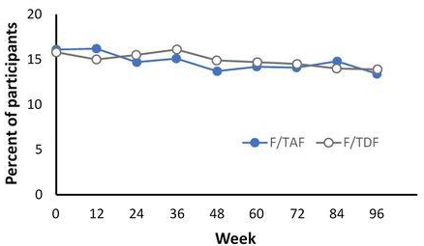
HIV and co-infections
Sexually transmitted infections (STIs): Transactional sex, acquisition
Significant proportion of chronic opioid users engaged in transactional sex, which is associated with higher rates of HIV/STIs, with sexual minorities much more affected
Matthew Ellis, PED1054
.
Rate of HIV acquisition was higher in participants with a history of rectal gonorrhea, rectal chlamydia or syphilis at screening
% of participants who tested positive for gonorrhea
or chlamydia by visit
Linda Gorgos, PDB0303
Notes:
Transactional sex as a pathway for HIV and rising sexually transmitted infections amidst the opioid epidemic
Matthew Ellis
BACKGROUND
Recently, the United States has experienced increases in associated HIV, sexually transmitted infections (STIs) and opioid use disorder. Discussion of HIV/STIs in association with the opioid epidemic typically centre on injection drug use and needle sharing. However, there are other pathways of infection associated with substance use, in particular the exchange of oral, anal or vaginal sex for drugs (i.e., transactional sex). The purpose of this study was to examine the prevalence and associated factors of transactional sex among a sample of chronic opioid users.
METHODS
Individuals entering one of 91 treatment centres across the United States for opioid use disorder (N=1,594) in 2018-2019 were surveyed on sociodemographic variables, opioid use patterns, the trading of sex (e.g., oral, anal or vaginal) for drugs, and history of HIV/STI diagnosis/treatment.
RESULTS
Transactional sex was endorsed by 24.0% of treatment-seeking opioid users. Sexual minorities had exceptionally high rates compared to heterosexuals (56.0% vs. 18.8%, p<0.001), as did females compared to males (41.7% vs. 13.5%, p<0.001) and opioid injectors compared to non-injectors (31.8% vs. 18.1%, p<0.001). In terms of HIV/STI history, those who exchanged sex for drugs were significantly more likely than those who have not to have been diagnosed with HIV (3.7% vs. 1.3%, p=0.002). In addition, transactional sex was associated with a greater prevalence of least one STI (59.7% vs. 27.6%), syphilis (16.1% vs. 1.8%), genital herpes (24.2% vs. 5.3%), chlamydia (30.1% vs. 11.9%) and gonorrhoea (32.3% vs. 11.4%).
CONCLUSIONS
The exchange of sex for drugs was endorsed by a significant proportion of chronic opioid users and associated with higher rates of HIV/STIs, notably syphilis. While transactional sex was higher among females and opioid injectors, what was most striking is the high engagement of this behaviour among sexual minorities. Opioid users, in particular sexual minorities, should receive increased engagement with prevention and intervention programmes designed to mitigate potential infection from transactional sex.
-------------------------------
Persistently high rates of sexually transmitted infections in the DISCOVER HIV PrEP trial
Linda Gorgos
BACKGROUND
In DISCOVER, F/TAF was noninferior to F/TDF for HIV PrEP in men who have sex with men and in transgender women. Here, we report STI outcomes during the trial through 96 weeks of follow-up.
METHODS
DISCOVER randomized 5387 participants 1:1 to receive blinded daily F/TAF or F/TDF for PrEP. Participation required documented HIV risk, determined by history of rectal STI, syphilis or sexual behaviours. STI testing (gonorrhoea, chlamydia and syphilis) and sexual behaviour computer-assisted self-interview (covering the preceding three months) occurred at screening and every 12 weeks. Statistical analyses for categorical variables used the CMH test, and comparisons of HIV incidence used a Poisson model.
RESULTS
At baseline, 430 (16.1%) of participants in the F/TAF arm and 421 (15.8%) in the T/TDF arm tested positive for gonorrhoea or chlamydia at any anatomic site; 299 (11.3%) and 279 (10.5%) tested positive at the rectum. The proportion of participants positive for gonorrhoea and chlamydia by visit is found in the figure. The overall incidence rate of gonorrhoea or chlamydia at any anatomic site was 85.7 and 83.1 per 100 person-years (PY) for F/TAF and F/TDF respectively, and for rectal gonorrhoea and chlamydia was 47.5 and 46.9 per 100PY. The 96-week prevalence of syphilis was 14.8% and 15.2% in the F/TAF and F/TDF arms, and the incidence rate was 9.9 and 9.3 per 100PY, respectively. The rate of HIV acquisition was higher in participants with a history of rectal gonorrhoea, rectal chlamydia or syphilis at screening (0.61 vs 0.12 per 100PY, p<0.001). The mean (SD) number of condomless receptive anal sex partners was 3.6 (5.9) vs 3.4 (6.2) at screening and 3.8 (7.3) vs 3.9 (7.8) at week 96 for F/TAF and F/TDF respectively.
CONCLUSIONS
STI acquisition rates, especially rectal gonorrhoea and chlamydia, remained stably high through 96 weeks of follow-up. In combination with sexual behaviour data, this argues against risk compensation in DISCOVER.

Slide 10
HIV and co-infections
Hypertension and diabetes
Integrated care package among elderly on ART for screening and management of diabetes, hypertension and other non-communicable diseases associated with:
Reduced morbidity
Enhanced diagnosis
Reduced clientele with increasing weight
.
Nagawa Elizabeth, PED0788
Notes:
An integrated healthcare package to improve the well-being of elderly clients with hypertension and diabetes receiving antiretroviral therapy at AIDS Information Centre (AIC) Kampala, Uganda
Nagawa Elizabeth
BACKGROUND
The increasing risk of diabetes, hypertension and other NCDs among the ageing population is becoming a major challenge in Uganda, most especially among HIV/AIDS clients. An integrated healthcare package was implemented at AIC Kampala to address the increasing morbidity trends due to either hypertension/diabetes among elderly clients stable on ART. It involved screening, monitoring and management of hypertension/diabetes alongside antiretroviral therapy. The main objective of this package was to increase early diagnosis and monitoring of diabetes and hypertension among elderly clients receiving ART treatment at AIC.
DESCRIPTION
This is based on results of a data analysis conducted in January 2019. A Friday clinic screened clients aged 50 years and older using BP measurements, fasting/random blood sugar, weight measurement and risk factor history. Those diagnosed were managed and monitored, and health education talks were held for all elderly people receiving ART at the clinic. There were bi-monthly weekly reports on client weight trends, new diagnoses and stable vitals. Diabetes and hypertension clients were continuously reviewed and monitored from February to December 2019. LESSONS LEARNED
Morbidity occurrences due to diabetes and hypertension among the elderly ART clients reduced to 30%. The percentage of clients diagnosed increased to 13% and 8% for hypertension and diabetes, respectively. The percentage of clients with increasing weight who attended health talks reduced by 20%.
CONCLUSIONS
To offer an integrated care package on screening and management of diabetes, hypertension and other non-communicable diseases associated with ageing to improve the well-being of elderly clients living with HIV.

