Slide 1
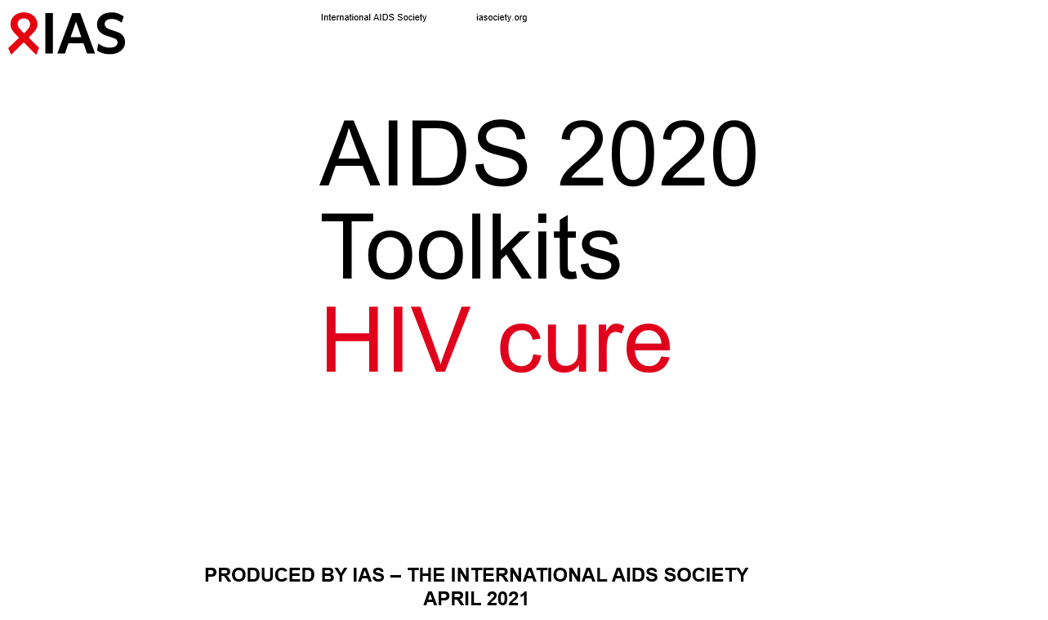

Slide 2
Contents
Introduction……………...…………………………………………………………………………………..............................................................................3
The first long-term remission of chronic HIV-1 infection without myeloablation?…………………………………………………………………………….5
Effects of immune-checkpoint inhibitors on anti-HIV specific immune responses and HIV reservoir in people living with HIV and cancer…………..6
Willingness to participate in short and extended analytic treatment interruption (ATI) during HIV remission trials…...………………………………….7
Th17 cells are early targets of SIV during acute infection in rhesus macaque vaginal challenge model………………………………………………….8
Induction of cross-neutralizing antibodies and protection from heterologous tier-2 SHIV challenge by an mRNA-based vaccine in macaques……..9

Slide 3
Introduction
Although combination ART has substantially improved the health of people living with HIV, it is unlikely that ART alone will end the epidemic. To fully alter the trajectory of the epidemic, a short-term intervention that results either in eradication or sustained control of the virus, a cure, might be needed.
A cure strategy could substantially improve an individual's quality of life by reducing comorbidities, treatment burden, stigma, and socioeconomic burdens.
In the face of recent stagnation of funding for HIV programmes and uncertainty over long-term stability of existing programmes, an HIV cure might present a financially sustainable solution to maintain the hard-fought progress made thus far and to reduce the risk of a resurgence of the epidemic.

Slide 4
Overview
HIV cure
Long-term remission of chronic HIV-1
Immune-checkpoint inhibitors
Short and extended ATI
Th17 cells
Cross-neutralizing antibodies

Slide 5

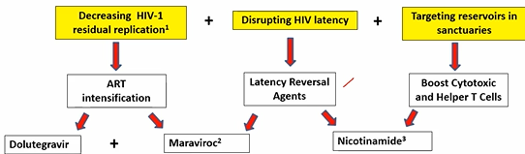
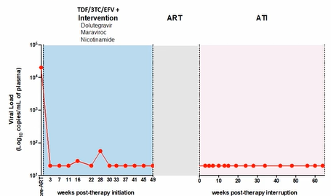
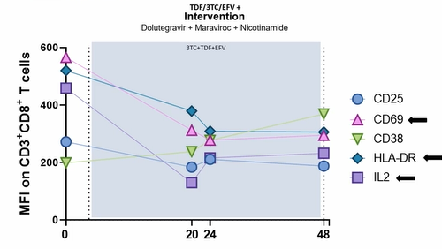
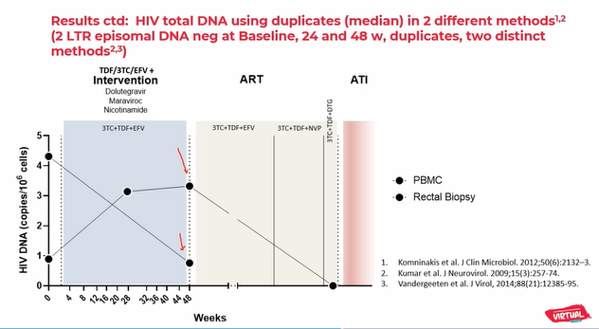
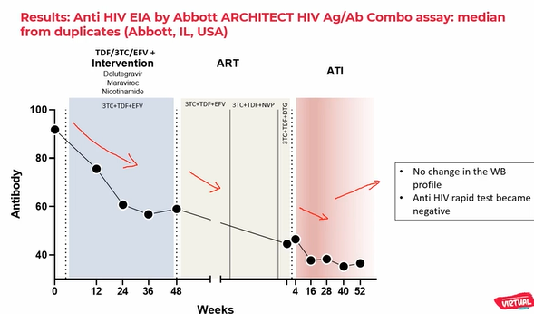
HIV cure
Y
The first long-term remission of chronic HIV-1 infection without myeloablation?
Remission is defined as the maintenance of undetectable levels of the virus for an extended period of time without adverse impact on health after ART interruption.
A 35-year-old male subject enrolled in the SPARC 7 Trial, included in the arm that received nicotinamide and ART intensification, exhibits long-term remission (64.7 weeks) after ATI.
Nicotinamide was used as a reversal agent and a booster of T-cell cytotoxic activity. MRV and DLG were used as intensification drugs.
During ATI, there were no VL bleeps; CD8
T-lymphocyte markers decrease; and HIV antibody titers also decrease, with no changes in WB.
Total HIV DNA was not detected in PBMC after ATI.
Further follow-up of all these parameters will be crucial to evaluate the successful of this intervention, as well as the outcomes of other subjects included in the trial.
Ricardo Diaz, OAXLB0105
This slide was developed by Natalia Laufer
Notes:
SPART 7 TRIAL
Study design
This was a randomized, open-label, pilot, proof-of-concept clinical trial [www.clinicaltrials.gov; ID: NCT02961829]. Study subjects were all male (this choice was done given the potential teratogenicity of one of the study drugs [Gao XY et al, J Appl Toxicol 2017]).
Randomized subjects were distributed within six arms with five subjects each followed every four weeks for a total of 48 weeks, with additional time for those subjected to DC vaccine. Selected subjects were ART suppressed for >2 years, with CD4+ T cell count nadir >350, harboring R5 HIV strains. Subjects were randomized to distinct intervention groups, as follows: 1) continuation of ART (control group); 2) intensified ART (continuation of ART+DTG and MVC (Group 2); 3) intensified ART and HDACi (ART+DTG+MVC+NA (Group 3); 4) intensified ART and Auranofin (ART+DTG+MVC+Auranofin (Group 4); 5) partially intensified ART (ART+DTG), followed by DC vaccine (Group 5); and 6) partially intensified ART (DTG)+NA+Auranofin, followed by DC vaccine (Group 6). Auranofin was used for the first 24 weeks of the study in G4 and G6.
Sera, plasma, PBMCs, saliva and urine were collected every month. Rectum biopsies were performed at baseline and at 48 weeks in Groups 1, 2, 3 and 4, and at the end of DC vaccine protocol in Groups 5 and 6.
Proviral DNA quantitation in PBMCs and rectum biopsies tissues: Viral DNA was measured as an estimate of the viral reservoir by published qPCR techniques [Komninakis et al., 2012; Buzón et al., 2010; Kumar et al. 2009] following in-house analyses aimed at ruling out the effect of PCR inhibitors. HIV-1 Episomal DNA Detection and Quantitation was performed according to [Buzon et al, Nat Med 2010, Sharkey et al Nat Med. 2000]. The qPCR quantitation values were normalized based on cell numbers estimated by CCR5 quantitation and are expressed as the number of DNA copies per 106 PBMC. T-cell activation markers: PBMCs were labelled with anti-CD3 APC and anti-CD4 PercP (for the lymphocytic subpopulation) and antiCD38 FITC and anti-HLA-DR PE (for cellular activation).
DC vaccine preparation: HIV Gag256-367 characterization from each subject was done using next-generation sequencing and single genome amplification. Design of autologous GAG peptides (nanomers) was according to the best immunogenicity (biding affinity >100) based on the specific HLA profile of each individual to elicit MHC Class 1 [Kai et al 2015; Benito et al 2004]. Between two and six peptides for each subject were prepared. Monocytes of each subject were obtained by cytapheresis and transformed into DCs. Exposure of DCs to autologous peptides and preparation of three doses of vaccine were injected into the axillar and inguinal subcutaneous region every two weeks.
Antibodies (Abs) quantitation: The researchers hypothesize that the decay/slope of Abs level will indicate constant suppression and directly relates to the size of the reservoir. We have performed Abs quantitation using the Abbott ARCHITECT HIV Ag/Ab Combo assay (Abbott, IL, USA).
The individual was diagnosed in 2012 and it was assumed to be a chronic HIV infection. His CD4 count at diagnosis was 372 cells/mcL, VL=20.221 copies/mL (October 2012). He initiated ART with 3TC/AZT/EFV in December 2012. In 2014, with undetectable VL, ART was modified to TDF/FTC/EFV. He entered the study in September 2015. Baseline laboratory: CD4= 720 cells/mcL (38%), undetectable HIV VL, R5 virus, subtype B. He was randomized to intensified ART and HDACi (ART+DTG+MVC+NA; Group 3). He exhibited two bleeps before ATI.

Slide 6
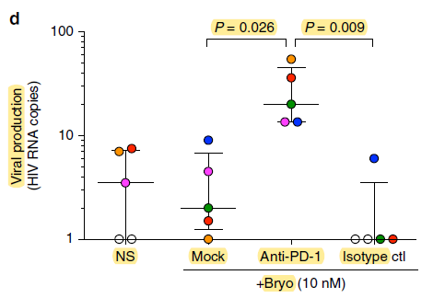
Effects of immune-check point inhibitors on anti-HIV specific immune responses and HIV-reservoir in people living with HIV (PLHIV) and cancer
HIV cureY
Immune checkpoint inhibitors (ICPi) are a major advance in cancer treatment. Whether they can act as a latency reversal agent towards an HIV cure is yet unknown.
Candidates for “shock and kill” strategy?
OncoVIRIM is a biological sub-study of the ANRS OncoVIHac prospective cohort: 19 individuals were included in the study.
Anti-PD-1 treatment was associated with :
  Early and transient T-cell activation
  Non-significant increase in HIV-specific CD8+ T-cells despite higher expression of PD-1 on HIV-specific CD8+ T-cells at baseline
There was no significant change in HIV reservoir, but two subjects presented persistent HIV-DNA decrease.
Anti-PD-1 in monotherapy do not significantly impact the HIV reservoir in clients treated for cancer.
Predictive biomarkers are still to be defined.
  Latent infection is enriched in CD4+ T cells expressing ICP
PD-1 blockade potentiates
HIV latency reversal ex vivo
No significant change in HIV DNA overtime in PLHIV treated with ICPi for cancer
Dramatic decrease of PD-1 staining and transient increase of CTLA4+ CD4+ T cells
Marine Baron, OAB0203
Notes:
ICP mediate immune escape in the context of tumoral diseases and chronic infectious diseases
In cancers, ICP inhibitors are currently used.
During chronic HIV infection:
ICP are upregulated on HIV-specific T-cells.
Latent infection is enriched in CD4+ T-cells expressing ICP.
Previous experiences of anti-PD1 therapy in people living with HIV with cancer
193 clients treated worldwide:
- Good safety in previously published cases
Anti-tumoral efficacy consistent with general population
Various effects on HIV reservoir
OncoVIRIM is a biological sub-study of the ANRS OncoVIHac prospective cohort:
ICP inhibitors, every 2 or 3 weeks, until progression or toxicity
People living with HIV virally suppressed on ART (VL ≤ 50 cp/mL)
Treated with ICPi for cancer
Blood samples: C1, C2, C3, C9, C15, C27 and C51 Or C1, C2, C3, C9, C18 and C36
Virological assays
Plasma HIV RNA
Total cell associated HIV DNA
Immunological assays
Activation phenotype (CD25, CD69, HLA DR, CD38, Ki67)
ICP and subsets phenotype (PD1, CTLA4, TIM3, CD27, CD45RA, CCR7)
Virus-specific T-cells by intracellular cytokines staining after viral peptide stimulation (IFN-ɣ, TNF-α, IL-2)

Slide 7
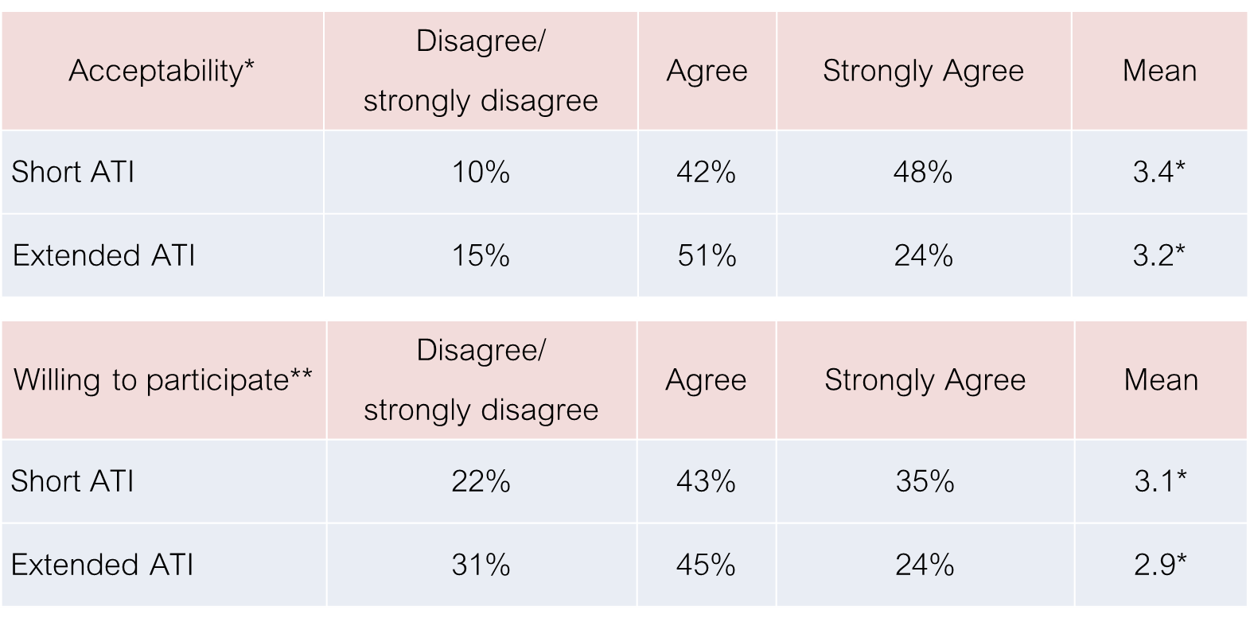
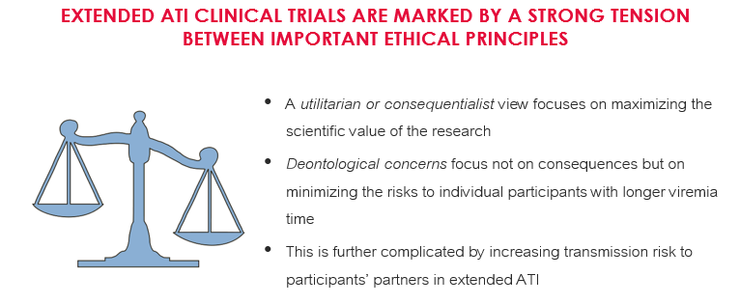
HIV cureY
Willingness to participate in short and extended analytic treatment interruption (ATI) during HIV remission trials
SURVEY RESULTS: 408 SEARCH MEMBERS.
Found both acceptable, and were willing to participate; but significantly less for extended ATI
ATI is part of scientific designs to evaluate efficacy of intervention in remission trials
Data from early remission trials show minimal clinical impact of short ATI
Was ATI and viremia time too short to demonstrate benefits of experimental agents?
Extended ATI implies a longer exposure to the potential risks associated with ATI for participants and partners.
Mean scores for acceptability and willingness to participate in studies with ATI were significantly higher for short versus extended ATI (p<.0001)
Willingness was higher in trials evaluating the efficacy of an intervention versus with ATI only.
Henderson Gail E, PED0761
Henderson Gail E, BS17 HIV cure
Notes:
Trials with short ATI
ATI is part of a scientific design to evaluate efficacy of intervention in remission trials
Scientific and ethical concerns
Data from early remission trials show minimal clinical impact of short ATI
Are people making an ‘irrational choice’ or joining for the ‘wrong reasons’?
Decisions about participating or declining* mainly voluntary and informed
Trials with extended ATI
Yet these early ATI trials failed to show success in durably controlling the virus
Most participants experienced rapid increased viral load and resumed ART
Was ATI and viremia time too short to demonstrate benefits of experimental agents?
Future HIV remission trials plan to extend the viremia period during ATI to evaluate therapeutic efficacy
CONCLUSIONS
Interviews with 33 SEARCH cohort members who had short ATI experience with viral rebound revealed half remained willing to participate in extended ATI trials. In a survey with 408 SEARCH cohort members, using hypothetical scenarios, we found higher willingness to participate in and acceptability of short vs extended ATI, though most were positive about both.
Research interest and endorsement, while varied, is expected to be high among participants in an existing cohort like SEARCH010/RV254
Based on our interview study with SEARCH cohort members (8,9), people will likely feel they can decline recruitment for extended ATI trial.
Increasing attention to transmission risks for partners of HIV remission trial participants, with longer ATI, raises thorny ethical questions (13) that need to be addressed
Factors related to transmission risk include:
persisting internalized stigma
low rates of HIV status disclosure
complications of having more than one partner
low understanding of U=U
If these barriers cannot be addressed, should extended ATI still be offered? Who should decide? What might community advocates or other stakeholders do to address these concerns?

Slide 8
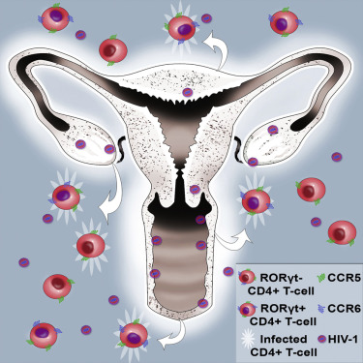
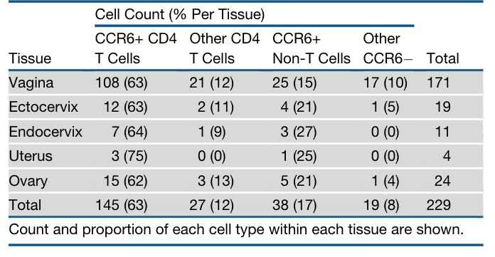
Th17 cells are early targets of SIV during acute infection in rhesus macaque vaginal challenge model
HIV cureY
Entire FRT is susceptible to infection
Identifying the initial target cells of HIV/SIV infection after mucosal exposure is essential to design effective treatment, prevention and cure strategies for control/remission of HIV. Although CD4+ T-cells of Th17 lineage have been identified as early targets of HIV/SIV in the female reproductive tract (FRT), this remains an area of debate.
This study employed a rhesus macaque vaginal challenge model to identify early targets of infection and to follow the infected cell phenotype changes over time. Using using a non-replicative luciferase reporter and SIVmac239 mixture, phenotyping of >5,000 SIV-infected cells at 72hrs and 96hrs identified infection throughout the FRT.
SIV-infected cells expressed the transcriptional regulator RORgt, confirming that the initial target cells are specifically of the Th17 lineage. There was also an increase in infection rate of immature dendritic cells and other T-cells as infection progressed.
Future work to compare distribution of infected cells and transcriptome profiles of infected and non-infected tissues at different time points will help understand dynamics and kinetics of virus distribution and dissemination during acute infection.
Distribution and proportion of SIV-infected cells
types arranged by site throughout the FTR
Muhammad Shoaib Arif, PDA0206
Stiehet al, 2016
Notes:
Studies looking at vaginal transmission face the inability to reliably detect rare infected cells.
Using the luciferase reporter and SIVmac239 mixture in the vaginal mucosa of simian immunodeficiency virus (SIV) allows routine identification of SIV-infected cell foci. This procedure helps us know the earliest and the preferred cell types for HIV to infect in the vaginal mucosa. Knowing the preferred cell types during SIV/HIV transmission is important as it may shed light on interactions between the virus and the host during the earliest events of transmission. It may also lead to designing more effective treatment, prevention and cure strategies for control/remission of HIV.
This was a longitudinal study that employed rhesus macaque vaginal challenge models to identify early targets of infection and to follow the infected cell phenotype changes over time using a non-replicative luciferase reporter and SIVmac239 mixture.
Twelve female RMs were challenged intravaginally with a non-replicative luciferase reporter, LiCH and SIVmac239 mixture. Animals were sacrificed 48-, 72-, or 96-hours post-challenge. The macroscopic luciferase signal detected by in vivo imaging system (IVIS) was used to identify FRT regions likely containing infected cells. Infected cells were phenotyped microscopically to identify Th17s (CD3+CCR6+) cells and other cell types involved.
Phenotyping of >5,000 SIV-infected cells in female reproductive tract (FRT) of eight RMs sacrificed at 72hr and 96hr post-challenge identified infection throughout FRT in 3/4 and 4/4 of 72hr and 96hr animals, respectively.
Comparing the two time points, proportion of infected Th17s remains constant (85 vs 70%). However, we can detect an increase in infection rate of iDCs (from 10% to 30%) and other T-cells (from 1% to 3%) as infection progressed. The use of serial sectioning allowed us to identify spread of infection across multiple cryosections of the same tissue. Also, plotting the coordinates of infected cells from multiple sections allowed us to visualize the infected cells in three-dimensional space and to follow the infected cells dissemination over the time.
In summary, results from this study found infectious foci throughout the reproductive tract. Phenotyping infected cells revealed that SIV has a significant bias for infection of CCR6+ CD4+ T-cells. The study further shows Th17 lineage CCR6+ CD4+ T-cells as primary targets of SIV during vaginal transmission.

Slide 9
HIV cure
Induction of cross-neutralizing antibodies and protection from heterologous tier-2 SHIV challenge by an mRNA-based vaccine in macaques
Although access to antiretroviral therapy has increased, HIV-1 transmissions will continue into 2030 and beyond unless an HIV-1 vaccine capable of inducing broadly neutralizing antibodies (bNAbs) and protection against diverse viral strains is available.
Interestingly, induction of cross-neutralizing antibodies and protection from heterologous Tier-2 SHIV challenge by mRNA-based vaccine in macaques demonstrated:
  Progressive induction of autologous HIV-1 neutralization in macaques during the course of the immunization phase
  Appearance of heterologous HIV-1 neutralization in macaques after repeated heterologous immunization
  Broad-spectrum heterologous tier-2 neutralization in macaques at the end of immunization period
  Protection against pathogenetic tier-2 SHIV (AD8) challenge in immunized macaques
  Anti-CD4 binding site antibodies correlated with protection against SHIV-AD8 infection in vaccinated macaques.
Paolo Lusso, OAALB0101

Slide 10
Acknowledgements
These slides were developed with the help of IAS/Abivax Research-for-Cure Academy Prize recipients Natalia Laufer, Rose Nabatanzi and Paradise Madlala

