Slide 2
Contents
Introduction…………………………………………………………………………………………………..3
Neural tube defects..…...…………………………………………………………………………………...5
Virologic failure, high viremia……………….………………………………………………………………6
Paediatric HIV infection and unsafe injection……………….…………………………………………….7
Viral suppression…………………………..…………………….…………………………………………..8
ART optimization……………………………………………………………………………………………..9

Slide 3
Introduction
Despite notable progress in reducing vertical transmission of HIV, the paediatric population remains significantly disadvantaged regarding access to treatment, with only 53% of children in need of receiving treatment in 2019.
Due attention is also needed for infants and children who have been exposed to HIV in utero and remain un-infected.
As the HIV epidemic matures, there is a growing population of adolescents living with HIV; in recent years, this particularly vulnerable group has seen a 50% increase in AIDS-related mortality compared with a decrease of 30% globally.
Achieving the Joint United Nations Programme on HIV/AIDS (UNAIDS) targets will remain an aspirational goal unless efforts to fill vital gaps in the HIV response for children and adolescents are intensified.
https://www.iasociety.org/cipher

Slide 4
Overview
Paediatrics
Neural tube defects
Virologic failure,
High viremia
Parenteral transmission
Viral suppression
ART optimization

Slide 5
Paediatrics Neural tube defects
The prevalence of neural tube defects in pregnancies with exposure to dolutegravir was similar to those with no exposure.
Karen Hoover, PEB0356
Notes:
Neural tube defects and adverse pregnancy outcomes after maternal exposure to dolutegravir and other antiretroviral medications during pregnancy, United States, 2013-2017
Karen Hoover
BACKGROUND
A study in Botswana found that exposure to dolutegravir, an integrase strand transfer inhibitor (INSTI), around the time of conception was associated with a slightly increased risk of neural tube defects (NTDs). Ongoing monitoring of dolutegravir use and NTDs and adverse pregnancy outcomes among US pregnant women is essential to evaluate the safety of dolutegravir and other antiretroviral (ARV) medications.
METHODS
We analysed IBM MarketScan commercial and Medicaid databases that included clinical diagnoses, procedures, medications and variables to link mother and infant pairs. We identified exposures to ARVs (dolutegravir, other INSTIs [raltegravir, elvitegravir], other ARVs, NTDs (anencephaly, spina bifida, encephalocele, iniencephaly) and pregnancy outcomes (live birth, stillbirth, spontaneous abortion, induced abortion). We compared the prevalence of NTDs and pregnancy outcomes among HIV-negative women and women with HIV by type of ARV.
RESULTS
Among 7,169 pregnancies in women with HIV, we found 235 exposed to dolutegravir. The prevalence of NTDs was 0 per 1,000 pregnancies among commercially insured women with HIV exposed to dolutegravir and 0.48 (95% CI 0.46-0.51) among HIV-negative women. The prevalence of NTDs was 0 per 1,000 pregnancies among Medicaid insured women with HIV exposed to dolutegravir and 0.58 (0.55-0.61) among HIV-negative women. The prevalence of NTDs were similar among women with HIV exposed to dolutegravir, other INSTIs or other ARVs, and among HIV-negative women (Table). The prevalence of stillbirth, spontaneous abortion and induced abortion were higher among women with HIV, including those exposed and unexposed to some classes of ARVs, compared with HIV-negative women.

Slide 6
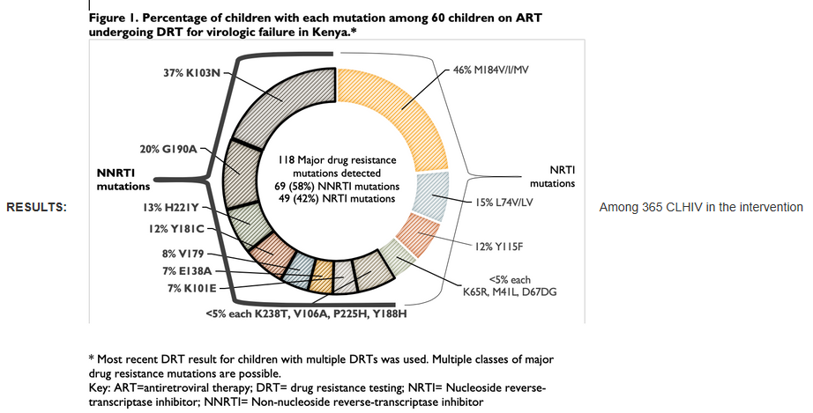
Paediatrics Virologic failure, high viremia
% of children with each mutation among 60 children on ART undergoing ART for virologic failure (VF) in Kenya
Half of children living with HIV with virologic failure have drug resistance requiring antiretroviral regimen change.
Lisa Abuogi, LBPEB08
Virologic suppression achieved in majority of paediatric and adolescent patients on third-line ART following failure of second-line PI-based ART
Appolinaire Tiam, PDB0403
Notes:
Half of children living with HIV with virologic failure have drug resistance requiring antiretroviral regimen change: Early insights from a randomized trial in western Kenya
Lisa Abuogi
BACKGROUND
Children living with HIV on antiretroviral therapy (ART) achieve low rates of virologic suppression. Most guidelines in resource limited settings recommend intensified adherence counseling and repeat viral load testing for children living with HIV with virologic failure (VF) on first line regimens without drug resistance testing (DRT). In an on-going randomized trial, we conducted targeted DRT testing for children with VF in the intervention arm.
METHODS
A total of 704 children living with HIV, ages 1-14 years, were enrolled in the Opt4Kids study from March to December 2019; they were from five government facilities in Kisumu County, Kenya. Children were individually randomized 1:1 to control (standard-of-care) or intervention (point-of-care viral load testing every three months with DRT for those with VF [>1000 copies/ml]) arms. DRT was performed for children living with HIV in the intervention arm using consensus sequencing and results discussed by a clinical management committee comprised of research staff, paediatric and HIV experts and facility healthcare workers. We use descriptive analyses to report the DR patterns and treatment recommendations.
RESULTS
Among 365 children living with HIV in the intervention arm (median time on ART 70.7 months), 60 (16%) had at least one DRT requested per protocol and 51 (85%) had DR mutations (DRM). Forty-eight (80%) children living with HIV with DRT had non-nucleoside reverse transcriptase (NNRTI) resistance, 36 (60%) nucleoside reverse transcriptase inhibitor (NRTI) resistance, 33 (55%) both NNRTI and NRTI, and nine (15%) had no resistance. In 30 children living with HIV (50%) with DRT results, an ART regimen change was recommended, and 90% of them were on an NNRTI-based regimen. The most common DRM are described in the Figure.
CONCLUSIONS
Early review of children living with HIV undergoing targeted DRT shows improved adherence alone is unlikely to result in viral suppression for a substantial proportion of children living with HIV with VF. Early DRT for children living with HIV with VF may be a critical tool in determining appropriate ART in order to ensure optimal health outcomes for children living with HIV.
HIV-infected treatment-experienced children and adolescents from sub-Saharan Africa: Clinical outcomes on third-line antiretroviral treatment in the New Horizons drug donation program
Appolinaire Tiam
BACKGROUND
Viral load (VL) scale up has highlighted significant rates of treatment failure among HIV-infected children and adolescents on antiretroviral treatment (ART) in sub-Saharan Africa. The aim of this study was to describe virologic and immunologic characteristics of children and adolescents with treatment failure on second-line ART and to describe their clinical outcomes on third-line ART.
METHODS
This is an observational cohort study collecting prospective data from patients aged 0-24 years on third-line ART in Eswatini, Kenya, Uganda and Zambia. We collected data from clinical record of patients initiated on darunavir (DRV) and/or etravirine (ETR) as part of third-line ART through the New Horizons drug donation program, sponsored by Johnson & Johnson. Baseline demographic, clinical and laboratory data (CD4 cell count and HIV RNA VL, genotypic resistance) were collected at the starting point of initiating third-line ART and summarized using descriptive statistics and median (IQR).
RESULTS
From December 2018 to November 2019, 152 participants were enrolled; 57.2% (87/152) were male; median (min-max) age at initiation of third line was 12.8 (1.3 ' 21.8) years. Prior second-line ART was PI-based, including lopinavir/ritonavir in 67.1%(n=102) and atazanavir/ritonavir in 17.8% (n=27). The NRTI backbone included lamivudine plus zidovudine in 20.4%, abacavir in 53.3%, or TDF in 23.0%. Most participants with available VL assessment (85.5%; n=130/152) had elevated VL within six months prior to switching: median (min-max) VL was 4.8 log (1.3 ' 6.5). Of the 123 patients with baseline resistance results, 89 (68.5%) had thymidine analog mutations (TAMs), 62.9% (n=56/89) TAM1 and 73.0% (n=65/89) TAM2 pathways. PI resistance mutations were observed in 71 (79.8%), with 70.4% (n=50/71) having accumulated >3 PI mutations. At six months on DRV/ETR-based third-line ART, of the 58 participants with VL results, 72.4% (n=42/58) had viral suppression. At 12 months on third-line ART, of 36 participants with VL results, 80.6% (n=29/36) had viral suppression.
CONCLUSIONS
Treatment-experienced paediatric and adolescent patients failing a second-line PI-based ART had high-level HIV viremia and high levels of NRTI thymidine analog and PI mutations. Among those patients with VL results available at six and 12 months on third-line ART containing DRV and/or ETR, the majority achieved virologic suppression.

Slide 7
Paediatrics Paediatric HIV infection and unsafe injection
Most likely mode of transmission in HIV outbreak in Larkana District, Sindh, Pakistan, in April 2019 was parenteral (unsafe blood transfusion and injections) in which 167 children had tested positive for HIV.
Fatima Mir, OACLB0102
Notes:
HIV infection and unsafe injection practice among children in Sindh, Pakistan: A case-control study of an outbreak
Fatima Mir
BACKGROUND
An HIV outbreak unfolded in Larkana District, Sindh, Pakistan, in April 2019. By December 2019, 1,167 children had tested positive for HIV. Our study evaluates risk factors for HIV in this population.
METHODS
We conducted a household-based, individually matched, case-control study. Cases (children aged <16 years registered for paediatric HIV care in Larkana City) and controls (HIV-uninfected children matched 1:1 by age, sex and neighbourhood) were sampled concurrently. Serum was collected from all participants for hepatitis B and C serology. Mothers of all participants were tested for HIV. Adjusted odds ratios (aOR) were estimated using conditional logistic regression to assess factors associated with HIV infection.
RESULTS
From 3 July to 26 December 2019, 403 HIV cases and 403 individually matched controls were recruited. Prevalence of HBV surface antigen and HCV antibodies were 18.4% (95% CI 14.7-22.5) and 6.5% (95% CI 4.3-9.3), respectively, among cases and 5.2% (3.3-7.9) and 1.0% (0.3-2.5), respectively, among controls. Only 7.0% of cases had HIV-positive mothers. In the six months prior to HIV testing, 228 (56.6%) cases and 32 (7.9%) controls reported >10 injections, and 294 (72.7%) cases and 78 (19.3%) controls had received an infusion. At least one blood transfusion was reported in 56 (13.9%) cases and 3 (0.7%) controls. HIV infection was independently associated with mother's occupation, history of blood transfusion (aOR 115.6, 95% CI 6.4-2091) and history of more injections/infusions (aOR 1.5, 95% CI 1.2-1.9), more than one visit to a government hospital (aOR19.9, 95% CI 2.6-155.2) and more visits to private clinics (aOR 3.1, 95% CI 1.9-5.2) in the six months prior to HIV testing.
CONCLUSIONS
HIV infection was associated with blood transfusion, multiple recent injections or infusions and more visits to healthcare facilities in this population. This establishes that the most likely mode of transmission in this outbreak was parenteral (unsafe injection).
Funding: Department of Paediatrics and Child Health, Aga Khan University, Karachi, Pakistan

Slide 8
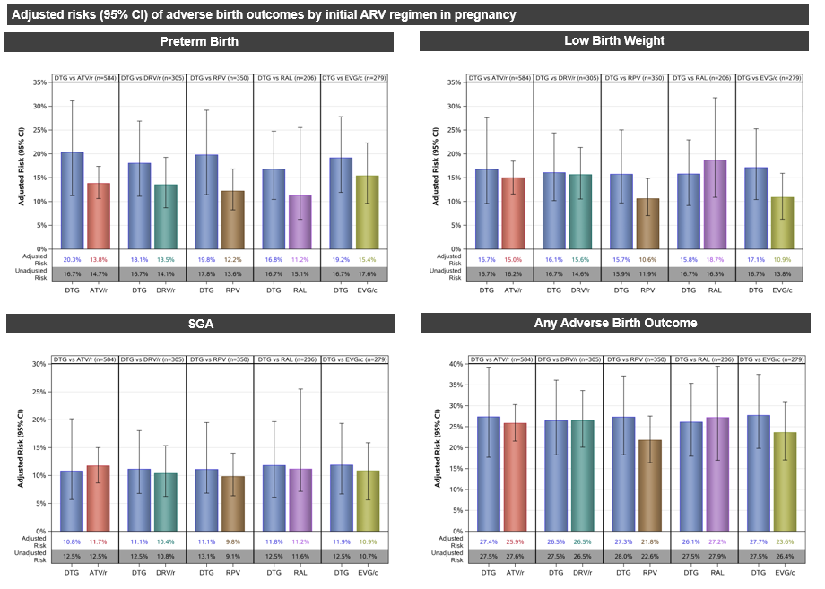
Paediatrics Viral suppression
DTG-based ART was more effective in achieving viral suppression by the end of pregnancy than ATV/r and RAL-based ART.
Kunjal Patel, PEB0278
Notes:
Viral suppression by delivery and birth outcomes among pregnant women living with HIV using dolutegravir in the United States: A comparative effectiveness and safety analysis
Kunjal Patel
BACKGROUND
Limited data exist on the effectiveness and safety of dolutegravir (DTG)-based antiretroviral therapy (ART) during pregnancy. We compared maternal viral suppression at delivery and infant birth outcomes among women living with HIV in the US who received DTG-based ART versus alternate preferred ART.
METHODS
Women enrolled in the Pediatric HIV/AIDS Cohort Study from 2007 to 2019 whose initial ART in pregnancy included DTG, atazanavir/ritonavir (ATV/r), darunavir/ritonavir (DRV/r), rilpivirine (RPV), raltegravir (RAL) or elvitegravir/cobicistat (EVG/c) were eligible. Viral suppression (<400 copies/mL) by delivery and adverse birth outcomes (preterm birth [<37 weeks gestation], low birth weight [LBW, <2,500 grams], small-for-gestational-age [SGA, <10th percentile for gestational age] and any adverse birth outcome) were evaluated. We estimated risk differences for each outcome comparing each alternate ART with DTG separately, adjusting for potential confounders.
RESULTS
In total, 101 women were exposed to DTG as part of their initial ART in pregnancy, 446 to ATV/r, 172 to DRV/r, 232 to RPV, 79 to RAL and 129 to EVG/c. Women were predominantly non-Hispanic and Black (66%) and 51% initiated ART prior to conception. Alcohol and illicit drug use was more common among women receiving DTG. CD4 counts were lower and viral loads higher early in pregnancy among women on DRV/r compared with DTG. DTG-based ART was more effective in achieving viral suppression by the end of pregnancy compared with ATV/r and RAL-based ART (Table). Estimated risks of preterm birth ranged from 11.0% to 18.1%, but there were no substantial differences in risks when comparing alternate ART with DTG-based ART. Estimated risks of LBW were increased for ATV/r and RAL-based ART by 6.2% and 8.3%, respectively, compared with DTG-based ART. Estimated risk of SGA was substantially higher for RAL than for DTG-based ART (14.5% vs. 7.5%). Risks of any adverse birth outcome ranged from 20.4% to 27.1% across regimens, with a 6.6% higher risk for RAL-based compared with DTG-based ART. CONCLUSIONS
DTG-based ART is associated with a greater likelihood of viral suppression by delivery compared with alternate ART in pregnancy. Although risks of adverse birth outcomes were similar between regimens, DTG was associated with lower risks for LBW and SGA compared with RAL.

Slide 9
Paediatrics ART optimization
Optimization to dolutegravir-based ART in a cohort of virally suppressed adolescents is associated with an increase in the rate of body mass index (BMI) change and odds of becoming overweight in adolescents living with HIV.
Alexander Kay, OAB0106
Notes:
Optimization to dolutegravir-based ART in a cohort of virally suppressed adolescents is associated with an increase in the rate of BMI change and odds of becoming overweight
Alexander Kay
BACKGROUND
Antiretroviral therapy (ART) regimens that contain dolutegravir (DTG) have been reported to be associated with increases in body mass index (BMI). However, this relationship has been poorly elucidated in adolescents, especially those in sub-Saharan Africa.
METHODS
BMI measurements in a retrospective observational cohort of 605 virally suppressed (<200 copies/ml³) adolescents living with HIV and enrolled in care at a clinical site in Eswatini were analyzed between one year prior to DTG initiation and up to one year after DTG initiation. In total, 295 females and 310 males had an average of 6.4 visits and a total of 4,040 visits within the study period. Two random-effects linear spline models, with knots at DTG initiation, were used to model the rate of change in BMI and the odds of becoming obese or overweight, as defined by WHO BMI-for-age cutoffs, while adjusting for sex, DTG companion drugs, previous ART regimens and age at DTG initiation.
RESULTS
In the first model, the rate of change in BMI was 0.316 kg/m² per year prior to DTG initiation and the rate of change after DTG initiation was 0.941 kg/m² per year (p <0.0001). The second model reported no change in the odds of becoming overweight or obese prior to DTG initiation (OR=0.998, p=0.136). After DTG initiation, the odds of becoming overweight or obese increased by approximately 1% every day (OR=1.010, p=0.015). Adolescents on TDF-3TC-DTG compared with ABC-3TC-DTG had higher BMIs on average, as did females compared with males. BMI did not vary significantly by previous ART regimens (nevirapine or efavirenz).
CONCLUSIONS
The results suggest that DTG initiation is associated with an increase in the rate of BMI change and an increase in the odds of becoming either overweight or obese in adolescents living with HIV. Further investigation is required to assess how DTG impacts BMI in adolescents following a longer duration of treatment. Future work in a larger sample of this cohort is planned to estimate a predictive tool to identify adolescents who are most likely to become overweight or obese after being optimized to DTG.

