Slide 2
Contents
Introduction…………………………………………………………………………………………………..3
Current efficacy vaccine trials….…………………………………………………………………………..5
Introduction of cross-neutralizing antibodies……………………………………………………………..6
bNAbs and HIV prevention…………………………………………………………………………………7
Challenges of HIV prevention efficacy trial design in the era of PrEP…………………………………8

Slide 3
Introduction
Soon after HIV was identified as the cause of AIDS in 1983, there was an expectation that an effective vaccine would be developed, tested and deployed within a few years. The intense research efforts of the past 35 years have generated important information on the virus and the disease, but a safe, effective and accessible HIV vaccine remains elusive.
Although other HIV prevention tools, such as PrEP, have become available, the need for an HIV vaccine as a critical component of the HIV prevention 'toolbox' remains critically important.
Passive immunity to HIV through the use of broadly neutralizing antibodies to provide antibody mediated prevention to HIV acquisition are also undergoing trials, the first results of which will be imminently available.
https://vaccineenterprise.org/

Slide 4
Overview
Vaccines
Current trials
bNAbs
PrEP

Slide 5
Vaccine s Current efficacy vaccine trials
Disappointing discontinuation of the HVTN 702 study/UHAMBO trial in South Africa.
However, other trials for vaccines are underway, such as:
HVTN 705/IMBOKODO (Ad26- Ad26/protein, heterologous double prime/ double boost)
HVTN 706/MOSAICO (Ad26-Ad26/protein, heterologous double prime/double boost)
HVTN 703/704/AMP (monoclonal antibody infusions of VRC 01)
PrEPVacc is a Phase 2b multi-arm combination trial underway in sub-Saharan Africa and Europe. It aims to evaluate the combination of PrEP and an HIV vaccine in an adaptive trial design.
Sinead Delany-Moretlwe
Notes:
HVTN – HIV Vaccine Trials Network
There are disappointing results. The HVTN 702 study/UHAMBO trial is designed as a Phase 2-3 trial to test efficacy and safety of a pox-protein heterologous prime boost; it is similar to RV144 but adapted to the Clade C virus most commonly found in South Africa. The study enrolled just under 5,500 men and women aged 18-35 years; it was evaluated at 14 sites in South Africa. Participants received six injections over the course of 18 months. However, in January 2020, the DSMV recommended stopping injections and continuing study follow up. This was because the experimental HIV vaccines regimen was ineffective in preventing HIV; the incidence in women were particularly high, reflecting higher background rates in South Africa. In this study, PrEP uptake was low.
HVTN 705/ IMBOKODO (Ad26- Ad26/protein, heterologous double prime/double boost):
Evidence of protection in NHP challenge model
Advanced in POC after meeting go/no go criteria in TRAVERSE
Evidence of protection in NHP challenge model
Heterosexual women in sub-Saharan Africa (2,500 women enrolled in South Africa)
5,407 participants fully enrolled
HVTN 706/ MOSAICO (Ad26-Ad26/protein, heterologous double prime/double boost) This study is being done in collaboration with the US military and Janssen:
Test an HIV vaccine regimen (Ad26 & bivalent gp140)/adjuvanted Clade C gp140 and Mosaic gp140
It will have two different groups (an active vaccine and a placebo group)
Global HIV study with sites all over the world USA (23 sites), Mexico (3 sites), Peru (5 sites), Brazil (8 sites), Argentina (4 sites), Spain (6 sites), Italy (3 sites) and Poland (3 sites)
A second efficacy trial evaluating strategy will be conducted in Latin America
Cisgender men and transgender individuals who have sex with cisgender men and/or transgender individuals
3,800 to be enrolled
Still early in implementation; COVID-19 impact
HVTN 703/704/AMP (monoclonal antibody infusions of VRC 01):
Evidence of protection in NHP challenge model
Being evaluated in men who have sex with men and heterosexual women
1,900+ 2,700 fully enrolled
AMP – Antibody Mediated Prevention – programme has been evaluating passive immunization using broadly neutralizing antibodies (bNAbs), namely VRC01 antibody. 2 Phase 2b trials 703 and 704 trial
703 trial enrolling women in seven countries in sub-Saharan Africa
704 trial enrolled men who have sex with men in USA, Latin America and Switzerland
If these trials prove successful, it is highly likely that there will be additional and more broadly neutralizing antibodies that will be evaluated in combination. Evaluations will move from infusions to more practical routes of delivery, such as subcutaneous delivery. The trials will also provide important data on the level of neutralizing antibodies required to prevent infection, which will inform future vaccine design.
PrEPVacc trial will assess two combination prophlylaxis/vaccine regimens each compared with placebo and the proportion of infections averted by F/TAF in comparison with TDF/FTC. HIV sero-conversions occurring between weeks 0 and 26 will inform the PrEP analysis, and infections after the 26 weeks will inform the vaccine analyses.

Slide 6
Vaccine Induction of cross-neutralizing antibodies
Despite intensive research over the past four decades, an HIV-1 vaccine capable of inducing broadly neutralizing antibodies (bNAbs) and protection from heterologous tier-2 strains is still wanted.
Study results provide evidence that extensive immunization with mRNA encoding multiple heterologous membrane-anchored HIV-1 envelope can induce cross-clade neutralization and partial protection from heterologous tier-2 virus challenge.
Paolo Lusso, OAALB0101
Notes:
Induction of cross-neutralizing antibodies and protection from heterologous tier-2 SHIV challenge by an mRNA-based vaccine in macaques
BACKGROUND
Despite intensive research over the past four decades, an HIV-1 vaccine capable of inducing broadly neutralizing antibodies (bNAbs) and protection from heterologous tier-2 strains is still wanted.
METHODS
We tested the immunogenicity and efficacy of an mRNA-based vaccine that expresses native, membrane-anchored HIV-1 envelope (Env) glycoproteins in combination with SIVmac239 Gag in order to promote the in vivo formation of virus like particles (VLP). Rhesus macaques were immunized with eight sequential mRNA immunizations or mRNA, followed by protein boosts with purified homologous SOSIP trimers, over a period of one year. The Envs included WITO (a Clade-B transmitter-founder strain) BG505 (Clade A) and DU422 (Clade C).
RESULTS
Env trimer-binding antibodies (Abs) were readily induced after the second immunization, showing increasing titers and durability after each booster injection. Following the third heterologous boost, cross-neutralizing Abs against tier-2 viruses of different clades started to appear in all animals, reaching higher and more stable titers after the last immunization. After challenge with heterologous tier-2 SHIV (AD8) by 12 repeated low-dose rectal inoculations, significant protection was observed in a group of animals, with no difference between those immunized with mRNA versus mRNA+protein. Extensive immunologic analyses identified three significant correlates of protection: i) Abs to a glycanated CD4-binding site (CD4-BS) gp120 core protein; ii) Abs to the AD8 Env trimer expressed on the surface of infected cells; and iii) Abs mediating ADCC against the closed AD8 Env trimer. Abs to both the CD4-BS and the trimer apex were visualized in the serum of protected animals by electron microscopy polyclonal mapping. By single B-cell cloning and antibody amplification from a protected macaque, we derived a panel of mAbs that share genetic similarities with previously identified macaque and human bNAbs against the CD4-BS. Detailed functional characterization of these mAbs will be presented at the conference.
CONCLUSIONS
These results provide evidence that extensive immunization with mRNA encoding multiple heterologous membrane-anchored HIV-1 Envs can induce cross-clade neutralization and partial protection from heterologous tier-2 virus challenge.
Funding: Supported in part by the intramural research programs of the NIAID DIR and VRC and by the NIH Office of AIDS Research (OAR).

Slide 7
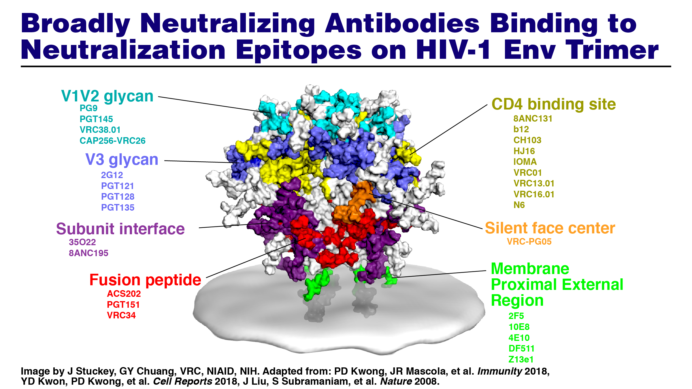
Vaccines bNAbs and HIV prevention
Understanding the potency, breadth and promise of broadly neutralizing antibodies (bNAbs) against HIV envelope for the prevention of HIV acquisition
Carl Dieffenbach
Notes:
Utilize HIV neutralization epitopes as immunogens to induce bNabs
Image shows the epitope map for broad neutralizing antibodies that bind to the HIV envelope.
There are a number of sites on the envelope referred to as sites of vulnerability, where the antibodies under investigation would bind.
Two efficacy trials are continuing (HVTN 705 and 706). In the next couple of years, we can expect a readout from HVTN 705, and HVTN 706 should be percolating along.
The evaluation of VRC01 (a broadly neutralized monoclonal antibody) for prevention of HIV infection will be completed shortly (AMP studies). In the next couple of years, the next steps on bNabs for HIV prevention and treatment will be moving forward.
High-level efficacy of injectable cabotegravir has been demonstrated in men who have sex with men; data in women is coming soon.

Slide 8
Vaccine s Challenges of HIV prevention efficacy trial design in the era of PrEP
Since the approval of PrEP in the USA in 2012, uptake rose from 5% to 19% among trial participants in two studies four years apart. As PrEP is very effective as a prevention tool, this is a challenge for testing new prevention tools, as well as for trial design.
Stephaun Elite Wallace
Notes:
One-day symposium held in Seattle, Washington, on 5 November 2018. Broad range of stakeholder groups: clinical triallists, ethicists etc. The challenge of designing future HIV prevention efficacy studies given the complicated and multiplicity of changes in field, such as PrEP uptake. The consensus was that: a) identifying participants who “opt out” of PrEP is ethical and acceptable; and b) requires complete transparency and ongoing participant education about effectiveness and availability of PrEP.
Sugarman et al. Lancet HIV 2019 stated: “… one potential approach would be to enrol participants for whom available prevention modalities are contraindicated (e.g. drug allergy) or otherwise unacceptable ...” and “(An) approach might evaluate individuals expressing interest in a trial and refer them to clinical services …”
Standard of prevention in efficacy trials:
As highly effective HIV prevention methods, including PrEP, are recommended worldwide for people vulnerable to acquisition of HIV, no person in a trial should be denied access to these interventions.
The exception to this is where it is highly biologically plausible that:
The intervention being tested is likely to be at least as effective as standard oral PrEP.
Taking oral PrEP and the experimental intervention together is likely to cause higher rates of side-effects with no added benefit.
Trial participants may have sound reasons for not wanting to take best-practice HIV prevention, such as drug intolerance. These people may opt out of PrEP use.
Post-trial access.
Providing research participants with access to proven interventions is required by the Declaration of Helsinki
In practice, this can be difficult to achieve due to regulatory delays once a product is proven effective and the trial has stopped. These delays can be out of the hands of the research team.
Research teams can ensure access for a period of time following a positive efficacy result by designing trials to have cross-over arms and/or follow-on trials to continue to provide the product (and gather further data) while regulatory processes and scale up occur.
In the Mosaico study:
Inclusion criteria: “individual ... Who is considered by the site staff to be at risk of HIV-1 infection”
Exclusion criteria: Individual who is taking PrEP at the time of screening and/or enrolment
We will be linking participants who are interested in PreP to PrEP services BEFORE screening begins through navigators and/or demonstration projects. We want all participants to make an informed choice. Participants who choose PrEP will not be enrolled in the study.
The target population for the study and the vaccine are those participants without a highly effective prevention strategy and for whom PrEP is not a current or desired CHOICE for HIV prevention.

